Slide 1
[A060R008L-SB01]
OVP issue
Corrective Action Report
Date: 2018/12/11

Slide 2
Content
Issue Description
Root Cause Analysis
Risk Assessment
Corrective Action
Preventive Action

Slide 3
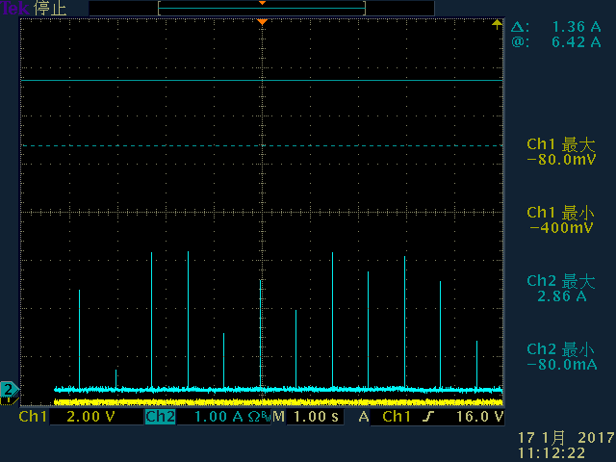
Issue Description
At first batch of MP in factory, some adapters can not turn on normally, failure rate was 0.12%. ACT, Pre-ATE and final-ATE caught the failure.
=>That means the test process can not 100% screen the failed samples.
Normal waveform
Abnormal waveform
(CH1:output voltage, CH2:output current)

Slide 4
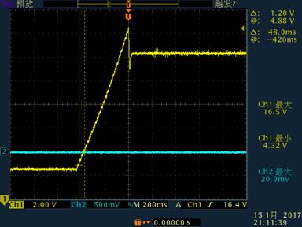
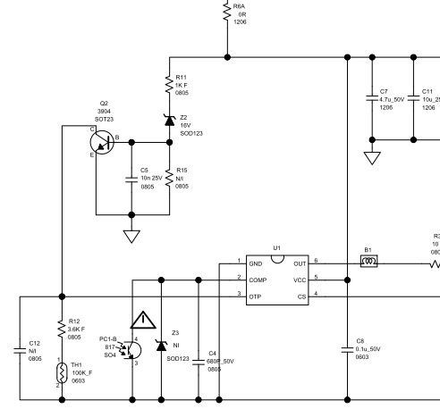
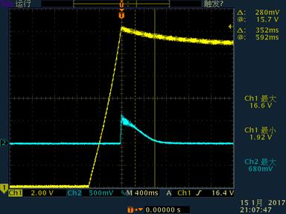
Root Cause Analysis
Check the waveforms of Vcc and Q2 during turn on, it shows V_{BE} goes high, and IC doesn’t work, Vcc can not be established successfully.
=>OVP triggered to cause adapter no output.
Normal sample
14.4V
OVP circuit
Failed sample
(CH1:U1 Vcc pin, CH2:Q2 V_{BE})

Slide 5
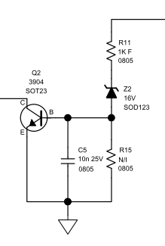

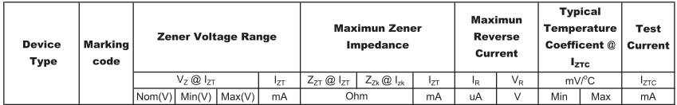
Root Cause Analysis
Review U1 and Z2 spec.
Vz(min)=15.68V, Vcc(steady state) =14.4V should be OK
But, 17V(Vcc on,max)>15.68(Vz,min_25C)+0.7(V_{BE})=16.38V
It is high risk OVP will activate during turn on.
U1 Vcc spec
Z2 spec

Slide 6
Root Cause Analysis
If OVP circuit to be triggered, adapter can not turn on normally.
=>V_{C7}>V_{Z2}+V_{BE} =>Ib occurs=>Q2 V_{CE} pull low=>U1 OTP pin triggered.
Ib occurs
V_{CE} pull low

Slide 7
Risk Assessment
Per the root cause analysis result, factory test process is not able to sort the bad samples completely from whole batch of samples. There is a big chance that OVP will activate during turn on and cause adapter has no output. The zener diode used in the circuit is a 16V range which has negative coefficient behavior. That means the lower temperature is, the more the risk will be. We can not predict how low the temperature will be at customer side. To prevent customer complaint as well as RMA return, sample rework is needed before shipment.

Slide 8
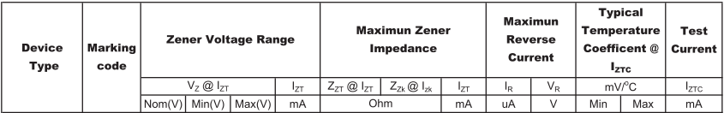
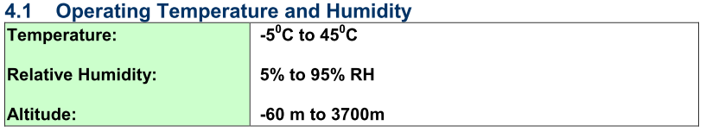
Corrective Action
Change Z2 from 16V to 18V as below.
17V(Vcc on,max)<17.64(Vz,min_25C)+0.7(V_{BE})=18.34V
=>It looks OK after change, we should check the worst case at operating temperature range.

Slide 9
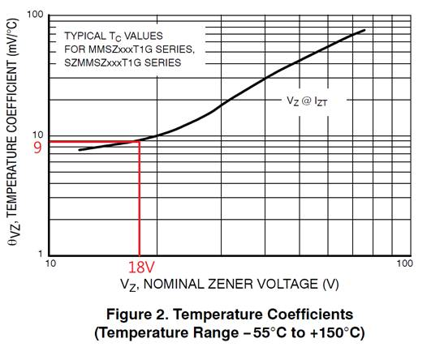
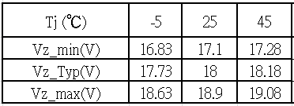
Worst case Study
(1)Vz data:
According to Z2 spec, temperature coefficient is around 9mV/℃ for 18V zener.
We can obtain the data of Vz vs. temp as below. The lowest value is at -5 ℃.
(2)Q2 V_{BE} data:
According to Q2 spec, V_{BE} range is 0.65~0.85V

Slide 10
Worst case Study
(3)Worst case condition check for turn on:
After component spec review, low temperature is the worst case.
At -5℃, 17V(Vcc on,max)<16.83(Vzmin_-5C)+0.65(V_{BE},min)=17.48V
=>No problem for turn on.
(3)Worst case condition check for OVP(spec<20V):
After component spec review, high temperature is the worst case.
At 45℃,
Vo_ovp=(Vzmax_45C+V_{BE},max+Vd)*Ns/Naux-Vd51=(19.08+0.85+0.7)*6/7-0.5=17.18V
=>No problem for OVP.

Slide 11
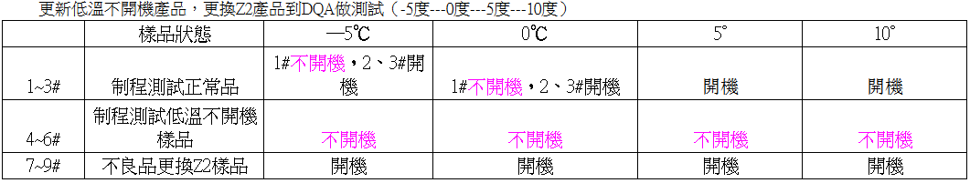
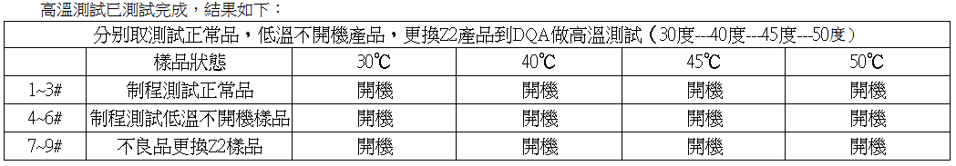
Test Result
(1)Low temperature turn on test=>pass
(2)High temperature turn on test=>pass

Slide 12
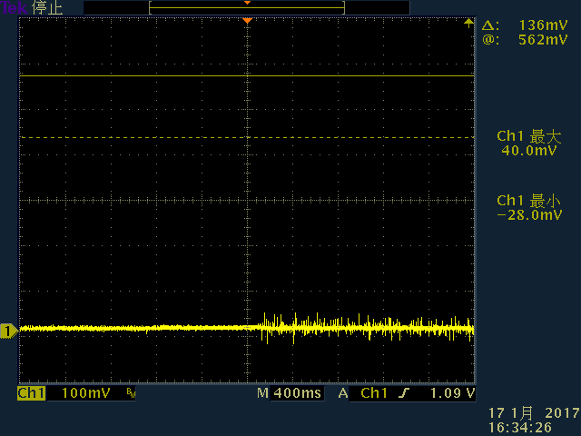
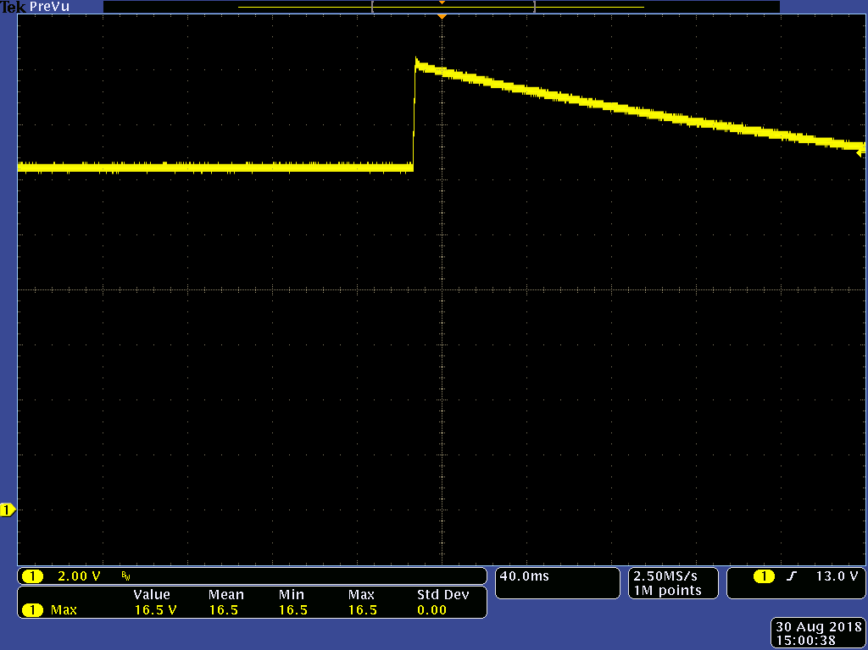
Test Result
(3)V_{BE} waveform after Z2 changed.=>Doesn’t go high during turn on.
(4)OVP=16.5V=>pass

Slide 13
Preventive Action
To avoid protection circuit fault trigger, we should check not only steady state but also turn on condition.
Worse case condition shall be checked.

